Slide 1
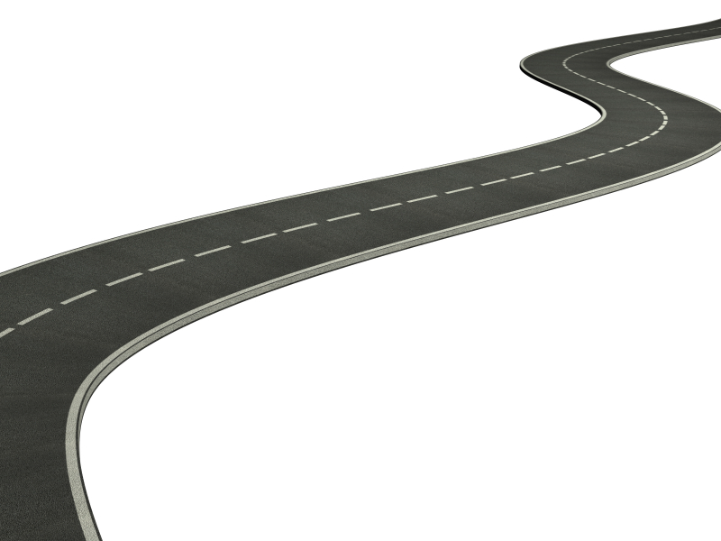
Vision of Success
Wise Planning
Strategic Response to
the Challenge of Change
Notes:
Life is a decision making journey. Each one of us navigates the world through decision making.
Organizations are no different. Organizations are led, guided and defined…by decisions.Ethics matters. Every day in every key decision.
Today we are going to deconstruct this concept of organizational integrity and reassemble it terms of a journey… a journey of decision making process.
(It will enable this examination if you have in mind a specific decision that you can use as a personal case study… a decision that you are very familiar with…as a participant or an observer, a decision that could have been made better. CONSIDER WHETHER TO HAVE THEM BRIEFLY DESCRIBE TO A PARTNER)

Slide 2
Collaboration is… the joining of individuals, groups, or organizations…
…to work together and make possible something that cannot be accomplished separately

Slide 3
Core Characteristics of Collaboration
There is a sense of interdependence
Differences are acknowledged & respected
Consensus is developed & maintained
There is shared responsibility
Constructive behavior is predictable

Slide 4
Mission Success
Wise Planning
Collaborative Negotiation
Values-Based Decision Making
>>> Dialogue >>>
Cornerstone Practices for
Creative Collaboration

Slide 5
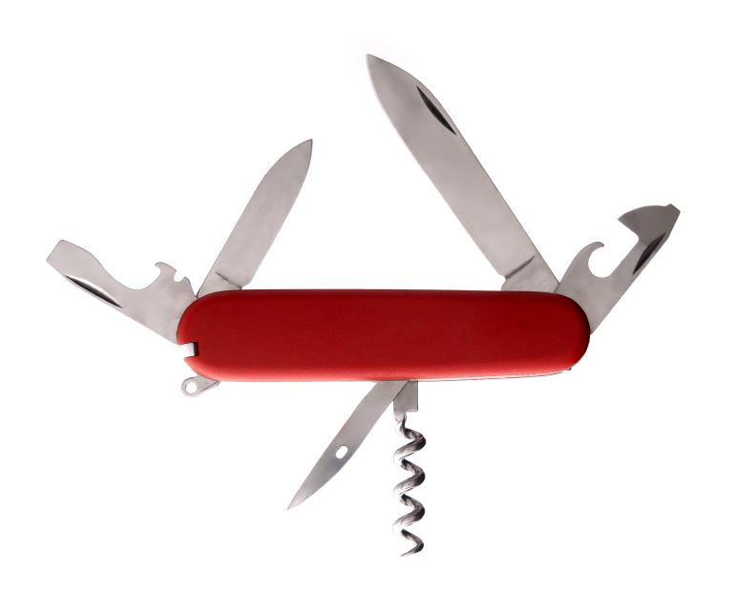
The Resilient Organization
Nimble
Adaptable
Focused
Notes:
The materials have a number of implementing worksheets that guide the process. Today, I want to mention three …
Decision Summary Help with the implementation of the clear, values-based message to your audience about the integrity and conviction of your decision.
Time Map A map to scale the VIA process to broader, more complex issues and to urgent, time compressed situations.
One Pager Structure for the preparation necessary for a deliberate, productive dialogue about the values that will guide a difficult choice.
Detailed Instructions Additional support for using the process on your own, step-by-step

Slide 6
Barriers to Wise Planning
Notes:
Types of barriers…. Stone walls, Deception, Attacks
Approaches…. AOM 59
Perspective
Resources
Pace/Procedures

Slide 7
Common Deficiencies
Poor design
Absence of key perspectives
Too many ‘cooks’
Flawed implementation

Slide 8
Compelling Vision
Understanding the Operating Environment
Actionable Goals
Elements of
Wise Planning
Clear Mission
Well-defined Core Values

Slide 9
A Clear Sense of Mission
Memorable
Inspirational
Purposeful

Slide 10
Develop a Strong Mission Statement
Brief (20 words or less)
Answers the essential WHY?
Clarifies basic direction
Example: The mission of the Nature Conservancy is to conserve the lands and waters on which all life depends.
PROTECTING NATURE, PRESERVING LIFE

Slide 11
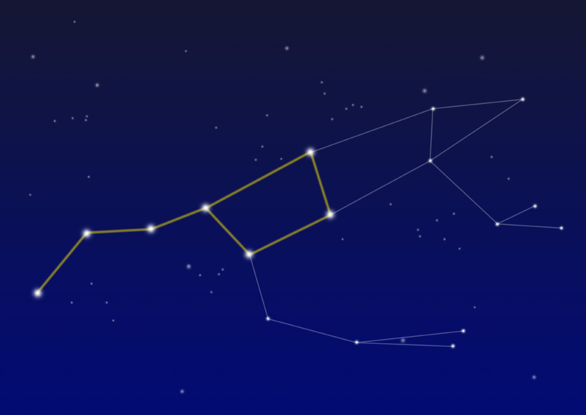
Increased accountability
Standards to raise the bar
Criteria for tough choices
The Power of Values
Notes:
Quote “Not everything that can be counted counts. Not everything that counts can be counted”
Sign Einstein’s office
This step in the VIA asks you to consider all the available options and determine which one the guiding values point to most directly
Another image…. Dovetail joint

Slide 12
Big word Basic meaning Behaviors to ‘walk the talk’
How to define core values
INTEGRITY
honesty, directness, and respect for commitments made
Foster trust by being truthful, empathetic
Be authentic and courageous, aligning what we are thinking, saying, feeling, and doing
Be responsible & follow through on our commitments

Slide 13
What does future success look like?
Notes:
There are five assumptions about the real nature of decision making that underlie the VIA process.
The beginning of wisdom is a humble admission that each of us has a limited perspective or lens. However, we can use the perspectives of others to focus our lens and improve our perspective.
A good decision making process grapples with the reality of multiple, limited perspectives and engages them, through dialogue, to see more clearly.

Slide 14
What a Clear Vision Offers
Dynamic tension (Pulling force)
Image of the future that inspires and lifts the heart
Focus that clarifies the path (interim goals and actions)
A compelling story that can attract funding and other support

Slide 15
Orientation.. Getting the ‘Map’ Right
Understand the operating environment
Think stakeholders
Precautionary
foresight
Notes:
The Leadership Challenge…
Kouzes and Posner wrote one of the all time best selling books on leadership, “The Leadership Challenge”
One of their key practices is “to model the way”
Challenging decisions are a crucible where leadership is tested and the consequences for the organization are significant. They are also opportunities to model the way.
It is the inherent responsibility of leaders….at all levels of the organization to convene the right kind of conversation about values, orient toward the best choice and help others understand why they chose that direction.

Slide 16
Situation Analysis
Clients, customers, payers
Trends
(P.E.S.T.)
Competitors & Collaborators
Opportunities
Threats
External
Internal
Strengths
Problems
Available Resources
Current Strategies
Current Performance Level

Slide 17
Considering Stakeholders
Implementers
Potential Beneficiaries
Interested or Concerned
Observers
Consultants
Decision Makers
Circles of Engagement
Reviewers/Evaluators
Potential Losers
Funders/Payers

Slide 18
Give me a lever long enough and a fulcrum on which to place it…
and I will move the world.
Archimedes
Action Plan with Deadlines and Accountability
Goal
Mission & Vision
Actionable Goals Provide Focus
Notes:
We can take the 3 dimensional nature of decision integrity and turn it into a practical structure with a long enough lever on to move a challenging decision issue in a positive direction.
One of the oldest of human principles for moving something difficult is leverage.
When we face a difficult decision, we need a path forward… a practical structure that enables a dialogue about what really matters
Values in Action or your own version of intentional, clear steps that increase clarity and conviction is the base, but what is the lever? GUIDING VALUES!
If we engage with different perspectives about importance (values) when making a decision. We can…
…. Benefit from alternative views
…. Seek consensus
…. Sincerely consider the stakeholders and give voice to their concerns
…. Face the challenge of explaining a decision to others and… for some decisions, the need to persuade and solicit support…or at a minimum gain acceptance so the decision does not fail because of resistance.
We can use the most important values to lift up the decision

Slide 19
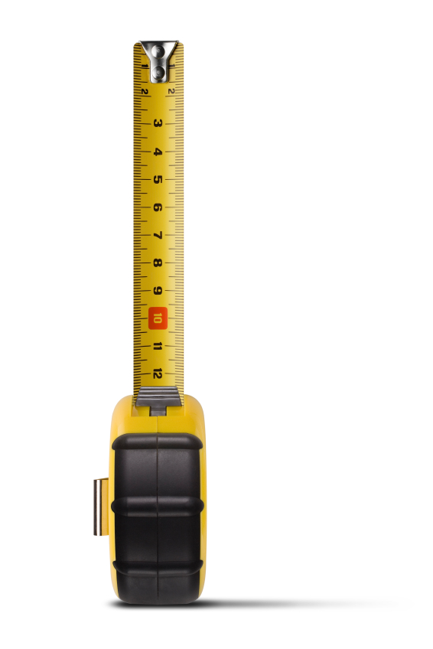
Measuring Success
Indicators
Metrics
(moving the needle)
Qualitative measures
Changes in attitudes/surveys
Notes:
To improve decision making, we have to tackle the universal challenge of limited time. One of the biggest dimensions of org. life that undermines org. integrity and ethical decision making is ‘time disease.’ It is hard to get the attention of leaders on improved decision-making process if they don’t see how it can fit within the pressurized time frames that they experience.
Therefore, this….or other approaches to this work…. Must be time-sensitive and adaptable…
1st answer to skepticism about the use of an approach like this…. “If you don’t have time to do it right, when do you have time to do it over.”
2nd answer…. It is simple to adapt the number of stops to the amount of time available to make the trip. More detail in Participant Guide Pp. 31-33

Slide 20
Create a One-Page ‘Blueprint’
Make the plan a living document
Commit to periodic view

Slide 21
Using a Blueprint Summary
The mission of ___ is to…
Our vision of success in 3 years is…
Our guiding values are…
-
-
-
Goal #1
Goal #2
Goal #3
Goal #4
Success Indicators (updated on _______)
a. b. c.

Slide 22
Vision of Success
Implementation, Review, Course Correction
Actionable Goals
Well defined Core Values
Mission Clarity
>>> Dialogue >>>
Understanding the Environment
Wise Planning

Slide 23
What You Can Do
Treat planning as a discipline and an ongoing conversation
At least annually develop a new plan or update your existing plan
Improve accountability by selecting key success indicators to monitor over time
Notes:
Churchill quote

Slide 24
Contact information for questions: 505.433.5439 mark@decisionres.com www.decisionres.com

Slide 25
Resources Strategic Planning for Public and Nonprofit Organizations: A Guide to Strengthening an Sustaining Organizational Achievement John M. Bryson (Jossey-Bass, 1995) Facilitator’s Guide to Participatory Decision Making Sam Kaner and others (Jossey-Bass, 2007) For a comprehensive list, go to: www.centerfornonprofitexcellence.org/resources/collaboration

